Slide 1
Activity Recognition
Anirudh Chaudhary, Quan Le, Hao Nguyen

Slide 2

Problem Statement
Predict activities of users
University of California Irvine
Samsung Galaxy S II
30 Volunteers (19-48 years old)
6 activities
3-axial linear acceleration
3-axial angular velocity at a constant rate of 50Hz

Slide 3
There are 10,299 obs and 561 features.
tBodyAcc-XYZ
tGravityAcc-XYZ
tBodyAccJerk-XYZ
tBodyGyro-XYZ
tBodyGyroJerk-XYZ
tBodyAccMag
tGravityAccMag
tBodyAccJerkMag
tBodyGyroMag
tBodyGyroJerkMag
fBodyAcc-XYZ
fBodyAccJerk-XYZ
fBodyGyro-XYZ
fBodyAccMag
fBodyAccJerkMag
fBodyGyroMag
fBodyGyroJerkMag
mean(): Mean value
std(): Standard deviation
mad(): Median absolute deviation
max(): Largest value in array
min(): Smallest value in array
sma(): Signal magnitude area
energy(): Energy measure. Sum of the squares divided by the number of values.
iqr(): Interquartile range
entropy(): Signal entropy
arCoeff(): Autorregresion coefficients with Burg order equal to 4
correlation(): correlation coefficient between two signals
maxInds(): index of the frequency component with largest magnitude
meanFreq(): Weighted average of the frequency components to obtain a mean frequency
skewness(): skewness of the frequency domain signal
kurtosis(): kurtosis of the frequency domain signal
bandsEnergy(): Energy of a frequency interval within the 64 bins of the FFT of each window.
angle(): Angle between to vectors.

Slide 4

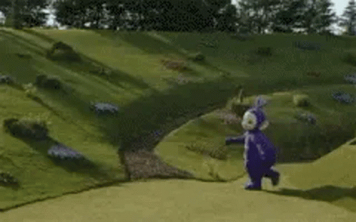
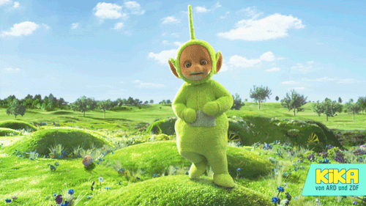
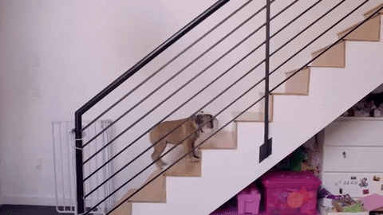

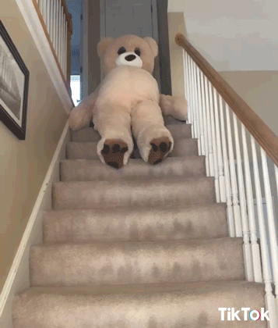
Six Activities Labels
1 | 4
2 | 5
3 | 6
Notes:
---------------------------ANIMATION SLIDE! ---------------------------
1-WALKING
2-WALKING_UPSTAIRS
3-WALKING_DOWNSTAIRS
4-SITTING
5-STANDING
6-LAYING

Slide 5
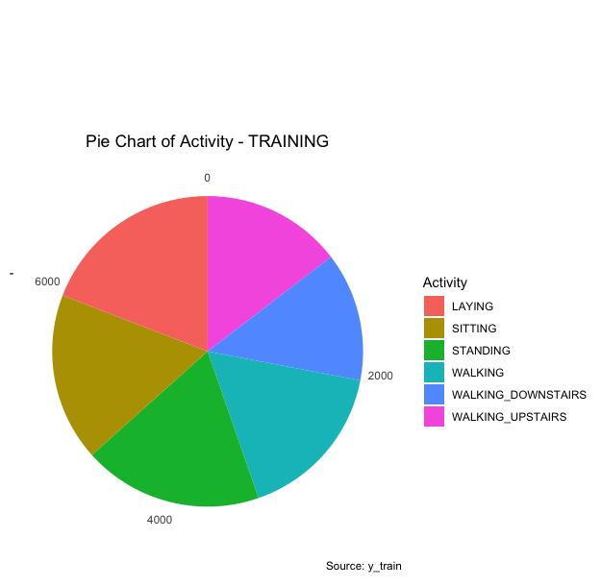
Data Visualization

Slide 6
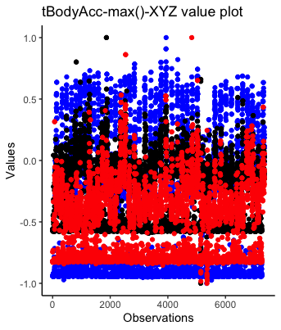

Slide 7
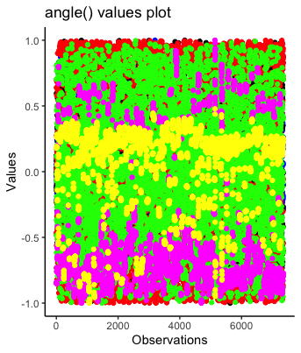

Slide 8
Data Preprocessing
Dataset already splits by 70% training and 30% testing.
There is no null value.
Change column name in the training and testing label.
Check for redundant data: res_train <- cor(X_train)
Check for imbalance data: Histogram for frequencies.
No data transformation as the data are numeric
Because we use KNN, SVM and Random Forest for machine learning models, no standardization is needed as all features are in the same unit of coordination.

Slide 9
Model
Model | Summary
KNN (k = 5, 10, 25) | 90.2%, 90.5%, 90.4%
Tuned SVMLinear | 96.1%
Tuned SVMPoly (Degree: 3-5) | Degree 5: 95.4%
RF (ntree= 100,200) | 90.4%, 91.9%
Neutral Network | MSE: 0.28

Slide 10
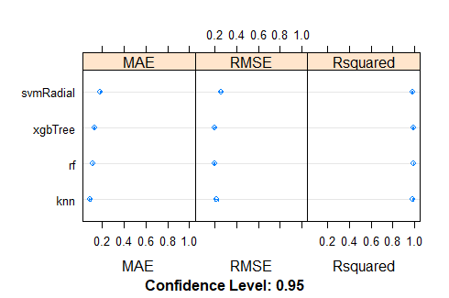
Ensemble

